Slide 1
Information Security Essential ISC511 (Week 7) 01-11-2021

Slide 2


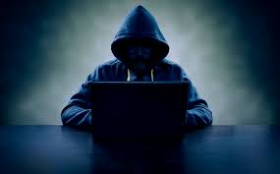
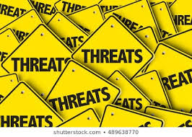
Threat Models
https://ocw.mit.edu/courses/electrical-engineering-and-computer-science/6-858-computer-systems-security-fall-2014/lecture-notes/

Slide 3
Outlines
Threat Models
Policing
Security Risk Vs Benefits
Examples

Slide 4
The Security Design
Security is also defined as “achieving some goal in the presence of an adversary”.
Many systems are connected to the Internet, which has adversaries.
Thus, design of many systems might need to address security, i.e. will the system work when there's an adversary?

Slide 5
High Level Plan for Thinking about Security
Policy: The goal you want to achieve. e.g. only Alice should read file F:
Common goals: confidentiality, integrity, availability.
Threat model: assumptions about what the attacker could do. e.g. can guess passwords, cannot physically grab file server Better to err on the side of assuming attacker can do something..
Mechanism: knobs that your system provides to help uphold policy. e.g. user accounts, passwords, file permissions, encryption.
Resulting goal: no way for adversary within threat model to violate policy. Note that goal has nothing to say about mechanism.

Slide 6
Why is Security Hard? Negative Goal
Need to guarantee policy, assuming the threat model.
Difficult to think of all possible ways that attacker might break in.
Realistic threat models are open-ended (almost negative models).
Contrast: easy to check whether a positive goal is upheld, e.g. Alice can actually read file F.
Weakest link matters.
Iterative process: design, update threat model as necessary, etc.

Slide 7
What’s the point if we can’t achieve Perfect Security
Each system will likely have some breaking point leading to compromise.
Doesn't necessarily mean the system is not useful: depends on context.
Important to understand what a system can do, and what a system cannot.

Slide 8
Security Risk Vs Benefit
In reality, must manage security risk vs. benefit.
More secure systems means less risk (or less consequence) of some compromise.
Insecure systems may require manual auditing to check for attacks, etc.
Higher Cost of attack means more adversaries will be deterred.

Slide 9
Better Security
Better security often makes new functionality practical and safe. Suppose you want to run some application on your system.
Large companies sometimes prohibit users from installing software that hasn't been approved on their desktops, partly due to security.
Javascript in the browser is isolated, making it ok (for the most part) to run new code/applications without manual inspection/approval (or virtual machines, or Native Client, or better OS isolation mechanisms).
Similarly, VPNs make it practical to mitigate risk of allowing employees to connect to a corporate network from anywhere on the Internet.

Slide 10
What goes wrong #1: Problems with the policy
Example 1: Sarah Palin’s email Account
https://en.wikipedia.org/wiki/Sarah_Palin_email_hack
Yahoo email accounts have a username, password, and security questions.
User can log in by supplying username and password.
If user forgets password, can reset by answering security Questions
Security questions can sometimes be easier to guess than passwords.
Some adversary guessed Sarah Palin's high school, birthday, etc.
Policy amounts to: can log in with either password or security Questions. (no way to enforce "Only if user forgets password, then ...")

Slide 11
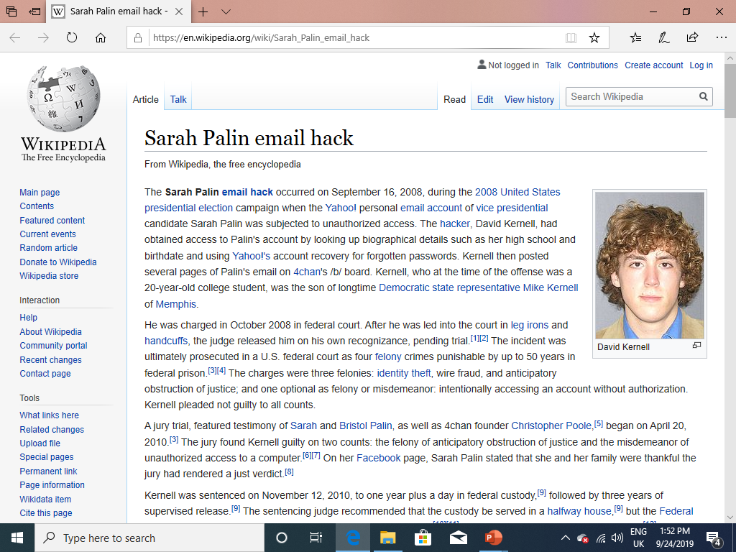

Slide 12
What goes wrong #1: Problems with the policy
Example 2: Mat Honan’s accounts at Amazon, Apple, Google etc.
https://www.wired.com/2012/08/apple-amazon-mat-honan-hacking/
Gmail password reset: send a verification link to a backup email address
Google helpfully prints part of the backup email address.
Mat Honan's backup address was his Apple @me.com account
Apple password reset: need billing address, last 4 digits of credit card. Address can be easy, but how to get 4 digits of user's credit card number?
Amazon: can add a credit card to an account, no password required.
Amazon password reset: provide any one of user's credit card no.
Amazon: will not print credit card numbers. But will print last 4 digits!

Slide 13
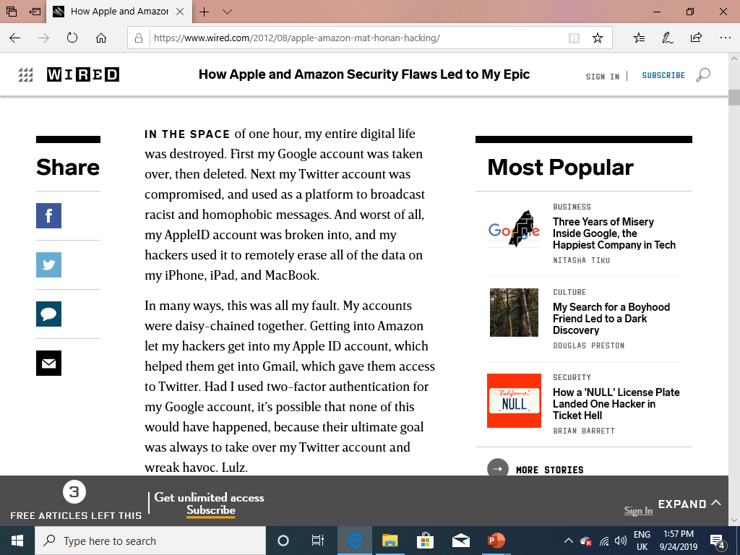

Slide 14
What goes wrong #1: Problems with the policy
Example 3: Twitter's @N account hijacking https://medium.com/@N/how-i-lost-my-50-000-twitter-username-24eb09e026dd
Can be hard for legitimate user to prove they own an account!
How to Solve?
Think hard about implications of policy statements.
Some policy checking tools can help, but need a way to specify what's bad. Difficult in distributed systems: don't know what everyone is doing.

Slide 15
What goes wrong #2: Problems with threat model/assumptions
Example 1: human factors not accounted for, example, phishing attacks
User gets email asking to renew email account, transfer money, or ...
Tech support gets call from convincing- sounding user to reset password
"Rubberhose cryptanalysis".

Slide 16
What goes wrong #2: Problems with threat model/assumptions
Example 2: computational assumptions change over time.
MIT's Kerberos system used 56-bit DES keys, since mid-1980’s.
At the time, seemed fine to assume adversary can't check all 2^56 keys.
No longer reasonable: now costs about $100
https://www.clou reasona dcracker.com/dictionaries.html
Several years ago, 6.858 final project showed you can get any key in a day

Slide 17
What goes wrong #2: Problems with threat model/assumptions
Example 3: All SSL certificate CAs are fully trusted
To connect o to an SSL-enabled web site, web browser verifies certificate.
Certificate is a combination of server's host name and cryptographic key, signed by some trusted certificate authority (CA).
Long list (hundreds) of certificate authorities trusted by most browsers.
If any CA is compromised, adversary can intercept SSL connections with a "fake" certificate for any server host name.
In 2011, two CAs were compromised, issued fake certs for many domains e.g., google, yahoo, tor //etc.
https://en.wikipedia.org/wiki/Comodo_Group
https://en.wikipedia.org/wiki/DigiNotar

Slide 18
What goes wrong #2: Problems with threat model/assumptions
Example 4: Assuming your hardware is trustworthy
If National Security Agency is your adversary, turns out to not be a good assumption.
https://www.schneier.com/blog/archives/2013/12/more_about_the.html

Slide 19
What goes wrong #2: Problems with threat model/assumptions
Example 5: assuming good randomness for cryptography.
Need high-quality randomness to generate the keys that can't be guessed.
Problem: embedded devices, virtual machines may not have much randomness. As a result, many keys are similar or susceptible to guessing attacks.
https://factorable.net/weakkeys12.extended.pdf

Slide 20
What goes wrong #2: Problems with threat model/assumptions
Example 6: Subverting military OS Security
In the 80's, military encouraged research into secure Operating Systems
Adversary gained access to development systems, modified OS code.

Slide 21
The End

